Slide 1

Introduction to Computer Science: Programming Methodology
Tutorial 11
RECURSIVE ALGORITHM
Frederick Khasanto
122040014
16 November 2023

Slide 2


Structure of a recursive algorithm
Computing factorials:
Base case or stopping condition
Original problem
Subproblem
Simplest case

Slide 3
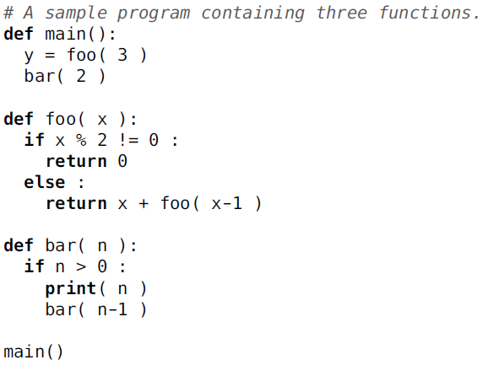
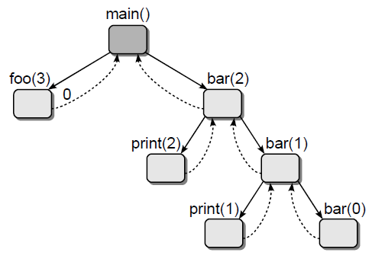
Recursive call tree-I
The recursive call tree consists of small boxes and directed edges between boxes. Each box represents a function call and is labeled with the name of the function and the actual arguments passed to the function when it was invoked.
The directed edges between the boxes indicate the flow of execution. The solid edges indicate the function from which a call originated. The dashed edges indicate function returns and are labeled with the return value if a value is returned to the caller.
The edges are listed left to right in the order the calls are made.
Questions:
1. What are the outputs?
2. What is the value of y?
3. What is y if you pass an even number to foo()?

Slide 4
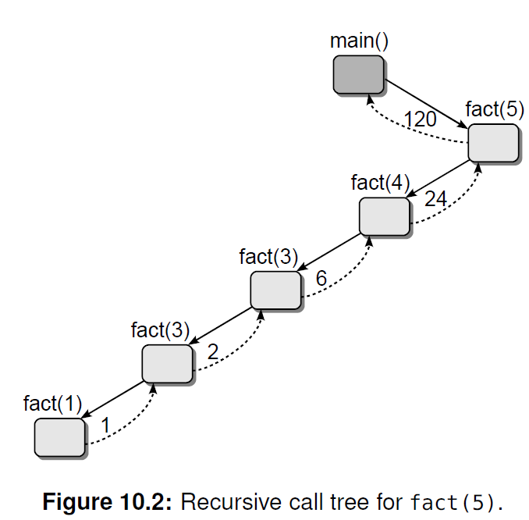
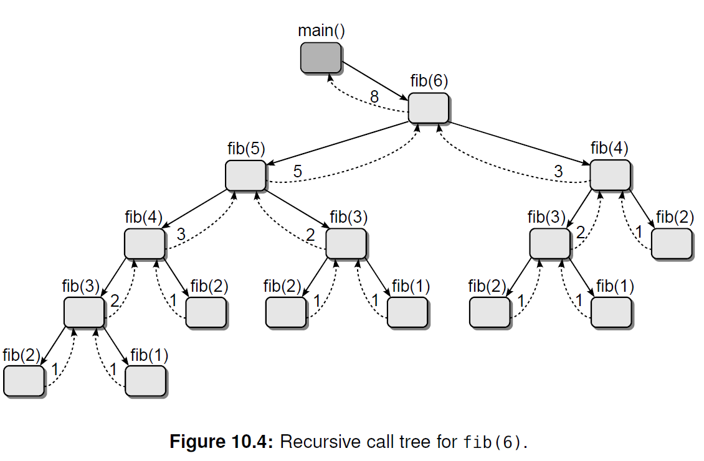
Recursive call tree-II
More examples:
Reference book: 《Data Structures and Algorithms Using Python》by Rance D.Necaise, Chapter 10

Slide 5
Q1: Number system conversion
i) Write a program that define a recursive function def conv(n, base) that can print out the binary(base=2) or octal(base=8) version of the decimal number n.
ii) Modify the program a little bit to provide a way for solving problem Q2 in Assignment 1. What about the reverse order?
iii) Try to draw the recursive call trees of the three programs respectively if the arguments are n=12,base=2 for (i) and n=3125 for (ii).

Slide 6
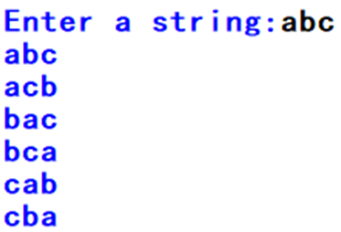
Q2: All Permutations of a string
Write a recursive program to print out all the possible permutations given a string with distinct characters. A sample run is as following. Draw the recursive call tree for this example.

Slide 7
Q3: Judge palindrome
Write a recursive program to define a function to judge whether it is a palindrome or not. If a string is equal to its reverse, then it is a palindrome. For example, “level” and “madam” are palindromes.

Slide 8
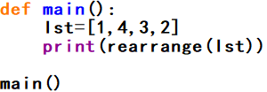
Q4: Rearrange a list
Write a recursive algorithm to rearrange a list of integer values so that all the even values appear before all the odd values. A sample run is as following. Draw the recursive tree given lst=[1,4,3,2] to be the input.

Slide 9
Q5: Find all the possible subsets
Write a recursive algorithm to find all the possible subsets of a list(excluding itself). A sample run is as following. In this example the list [1,2,3] is passed to the function and a list of all subsets is returned. Draw the recursive call tree given the list [1,2,3] as an example. You should be able to rediscover following output by looking at the recursive call tree.

Slide 10
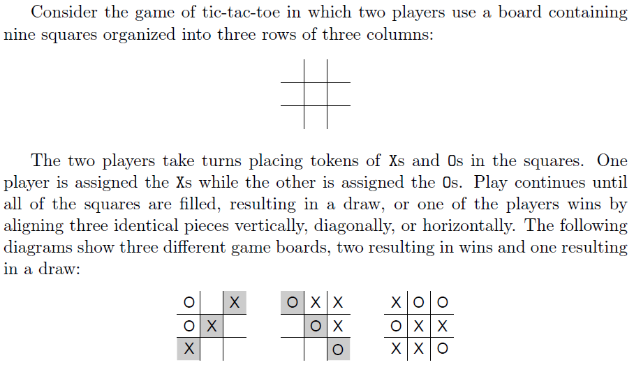
Q6: Playing Tic-Tac-Toe-I

Slide 11
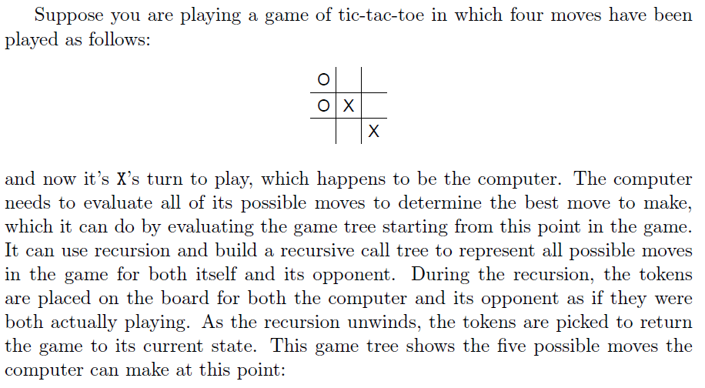
Q6: Playing Tic-Tac-Toe-II

Slide 12
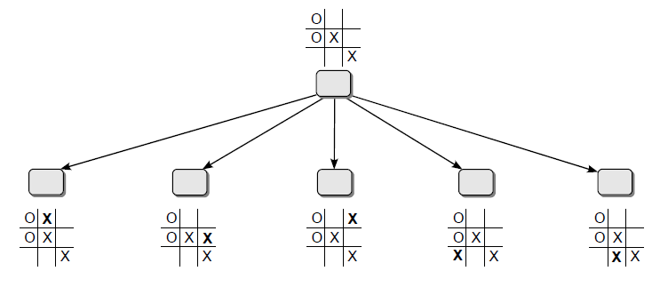
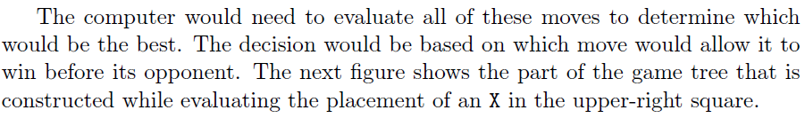
Q6: Playing Tic-Tac-Toe-III
“The game tree”
Try to design a recursive algorithm for computer to determine where it should move. And write a program to allow you and computer to compete and to see whether you could win or not. Either ○(moves first) or × could be chosen.

